Slide 1
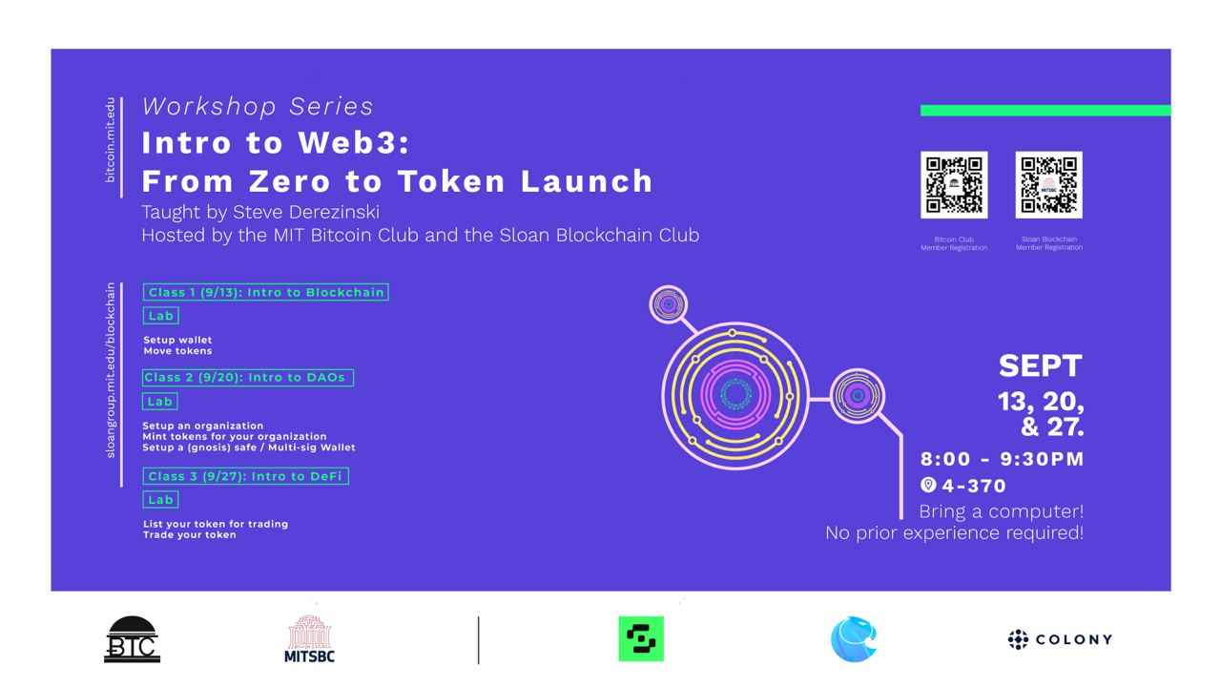

Slide 2
Intro to Web3
Class 1: Intro to Crypto, Blockchain, Wallets

Slide 3
About me
Education
MIT Undergrad in Mech Eng (robotics)
MBA MIT Sloan Fellow in Global Leadership and Technology Innovation
Crypto/Blockchain Work:
Founder of Hashchat.xyz – web3 messaging
Developed tokenomics framework for crypto startup
Taught Blockchain Ventures at MIT Media Lab
Consulting with Large Multinational organizations on Blockchain Implementations

Slide 4
Cryptocurrency: The Internet of Money
Blockchain: The Internet of Value
World Wide Web: The Internet of Info
Notes:
Starting with the internet we know today – “information wants to be free”
All copies everywehre – great media platform. Customizeable. Killed newspaper classifieds. But gave rise to eBay and craigslist.
Building major global businesses was the norm, all companies needed a “world wide web strategy”
Now, there’s a problem. What if we want to claim we own something? What is one unique item on the web? No such thing. There are domain names? And email addresses? -- those became the defacto standard way to identify yourself. -- which is the root problem of defining something as unique.
Now currency – there is a problem with digital currency called the “double-spend” problem. If I can create and manage currency on the web, we have [continue on the unique aspect]
BLOCKCHAIN – internet of value – provable uniqueness agreed by global consensus for every transaction (exchange of value – typically cryptocurrency for some asset)
QUOTE: “Bitcoin is to the dollar as the Internet is to paper.”
-Tim Draper

Slide 5
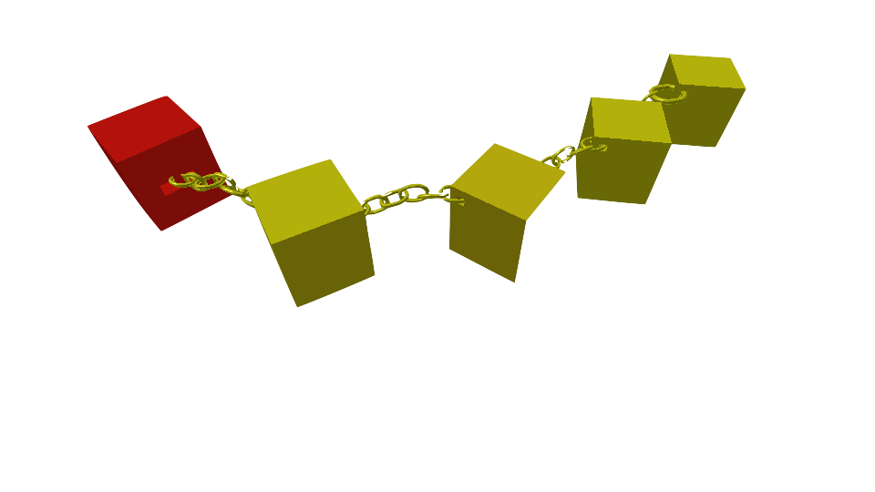
What is a blockchain?

Slide 6
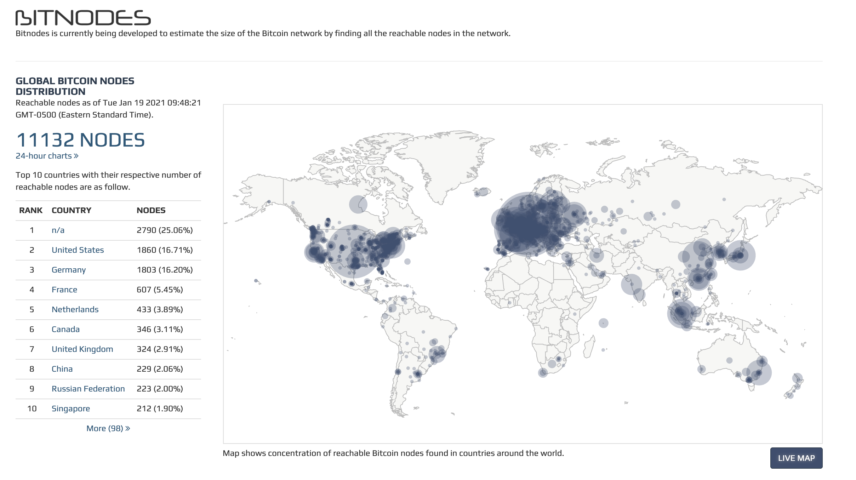
Live Bitcoin Nodes (Jan 2021)

Slide 7
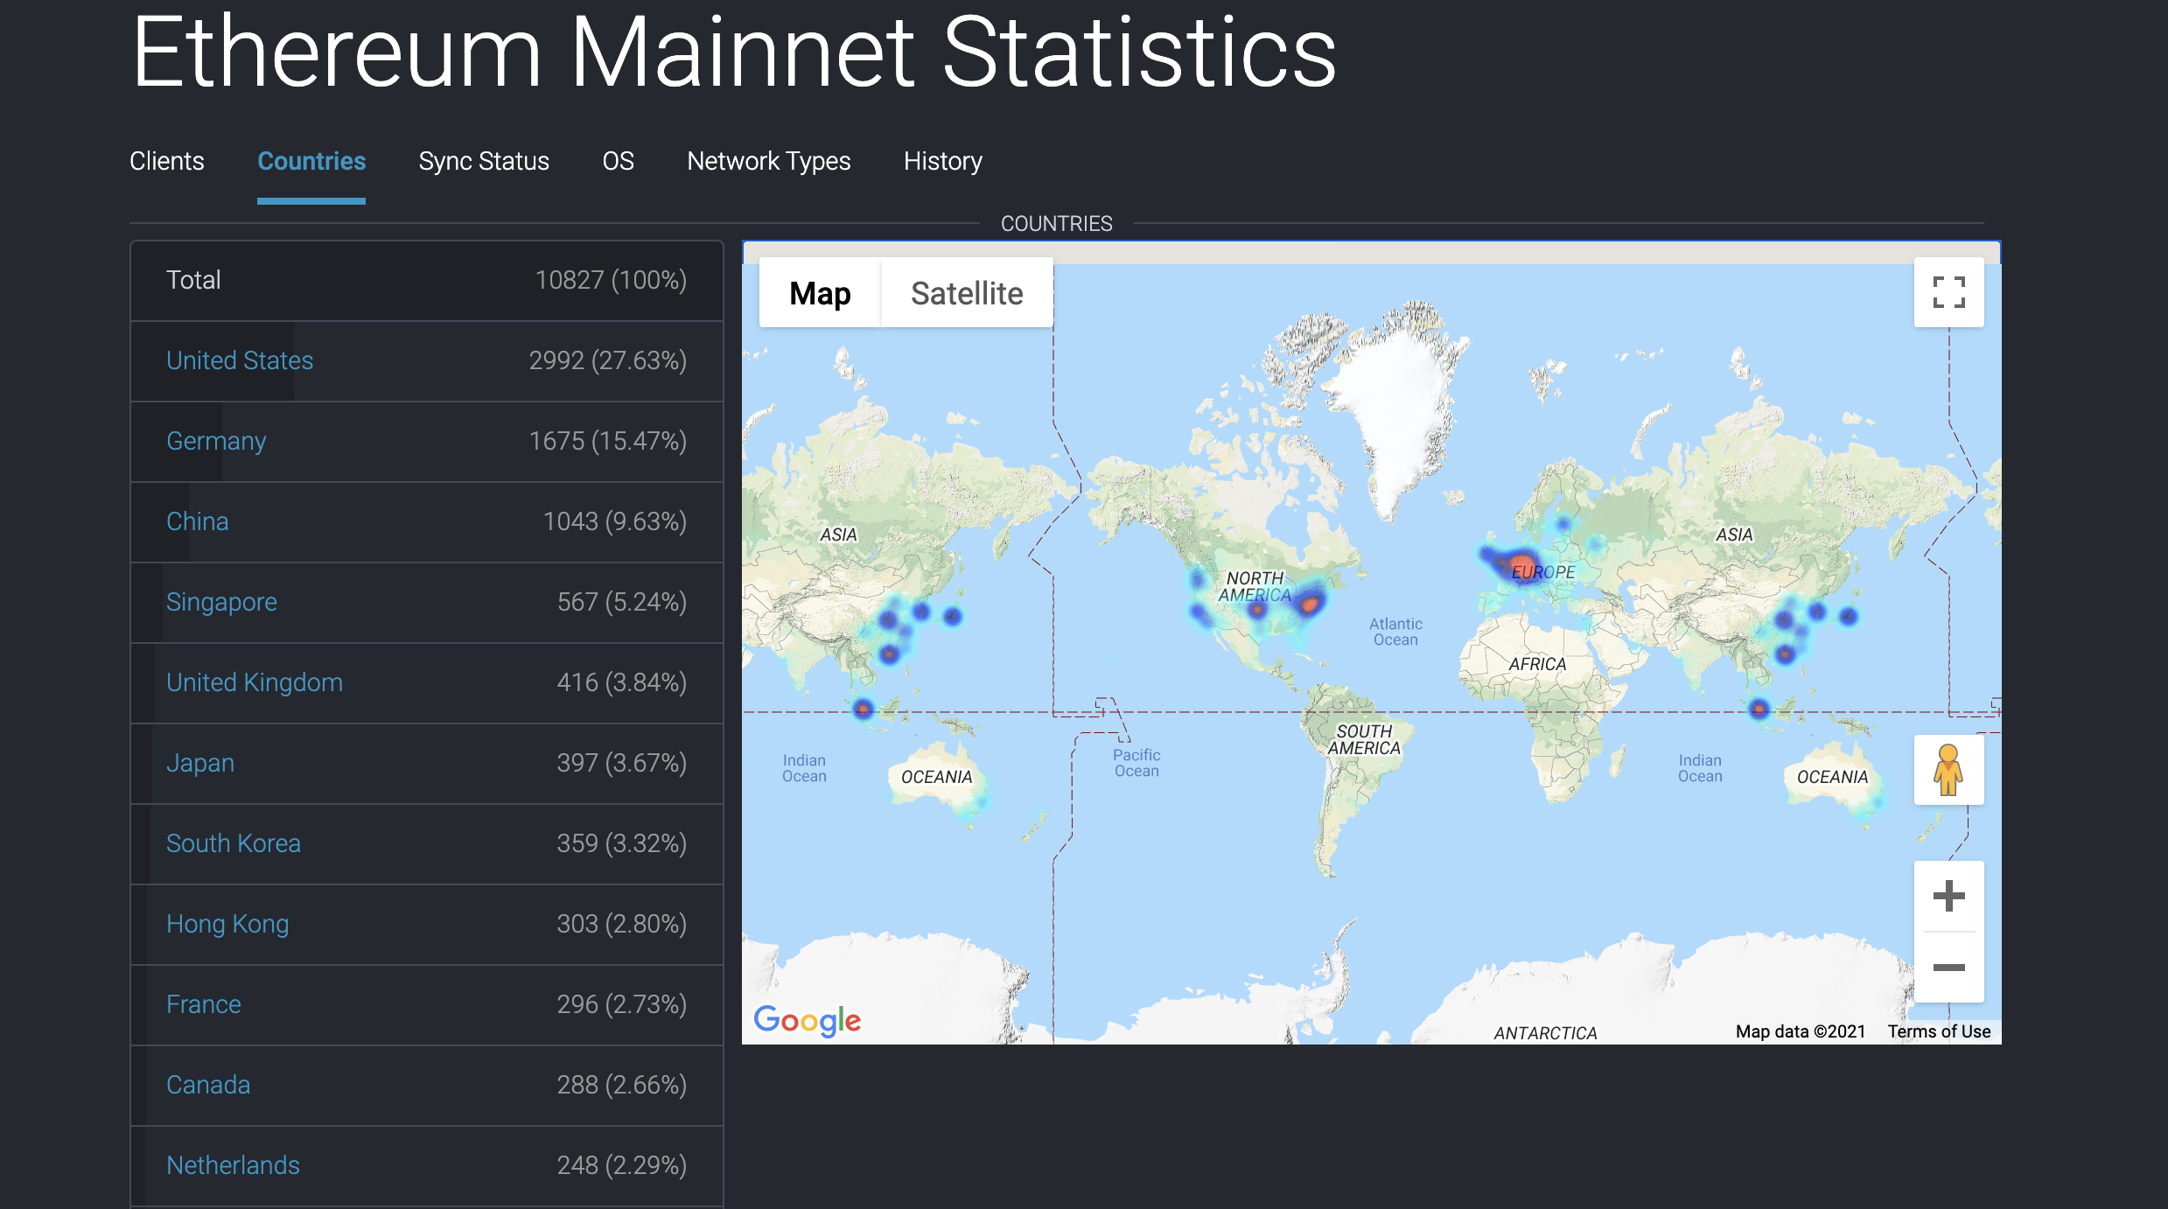
Live Ethereum Nodes (Jan 2021)

Slide 8
Visualize Live Ethereum Chain
https://txstreet.com/v/eth

Slide 9
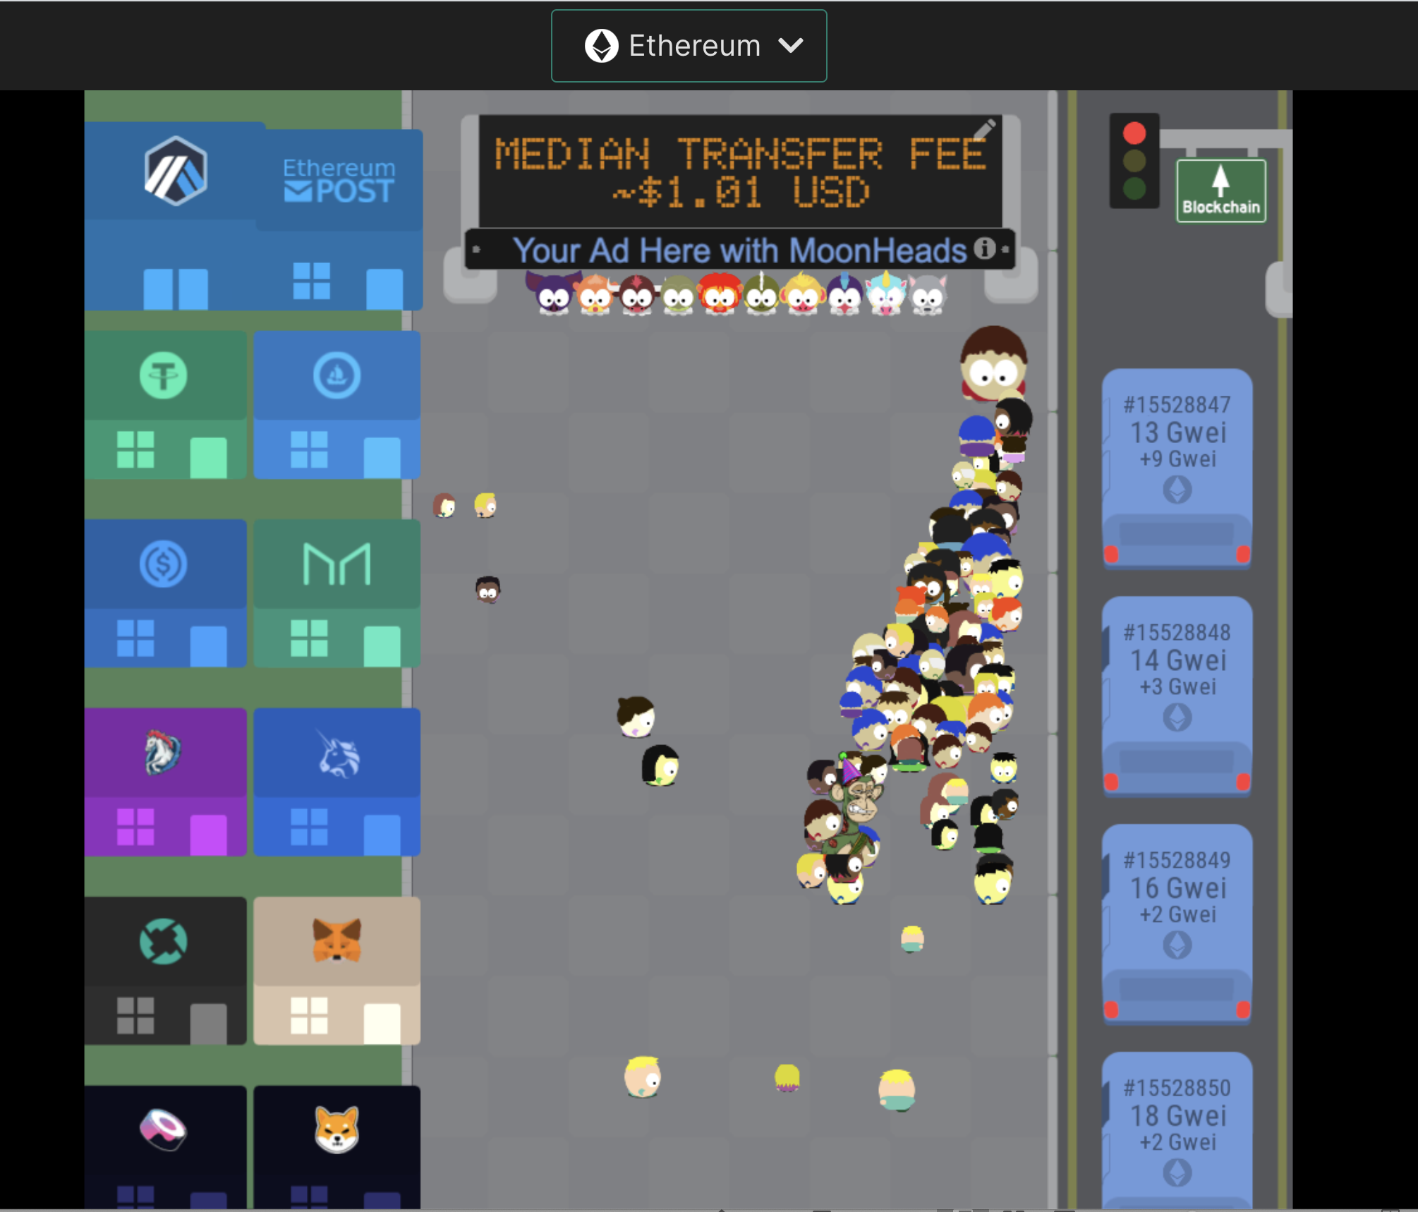

Slide 10
Cryptocurrency: The Internet of Money
Blockchain: The Internet of Value
World Wide Web: The Internet of Info
Notes:
Starting with the internet we know today – “information wants to be free”
All copies everywehre – great media platform. Customizeable. Killed newspaper classifieds. But gave rise to eBay and craigslist.
Building major global businesses was the norm, all companies needed a “world wide web strategy”
Now, there’s a problem. What if we want to claim we own something? What is one unique item on the web? No such thing. There are domain names? And email addresses? -- those became the defacto standard way to identify yourself. -- which is the root problem of defining something as unique.
Now currency – there is a problem with digital currency called the “double-spend” problem. If I can create and manage currency on the web, we have [continue on the unique aspect]
BLOCKCHAIN – internet of value – provable uniqueness agreed by global consensus for every transaction (exchange of value – typically cryptocurrency for some asset)
QUOTE: “Bitcoin is to the dollar as the Internet is to paper.”
-Tim Draper

Slide 11
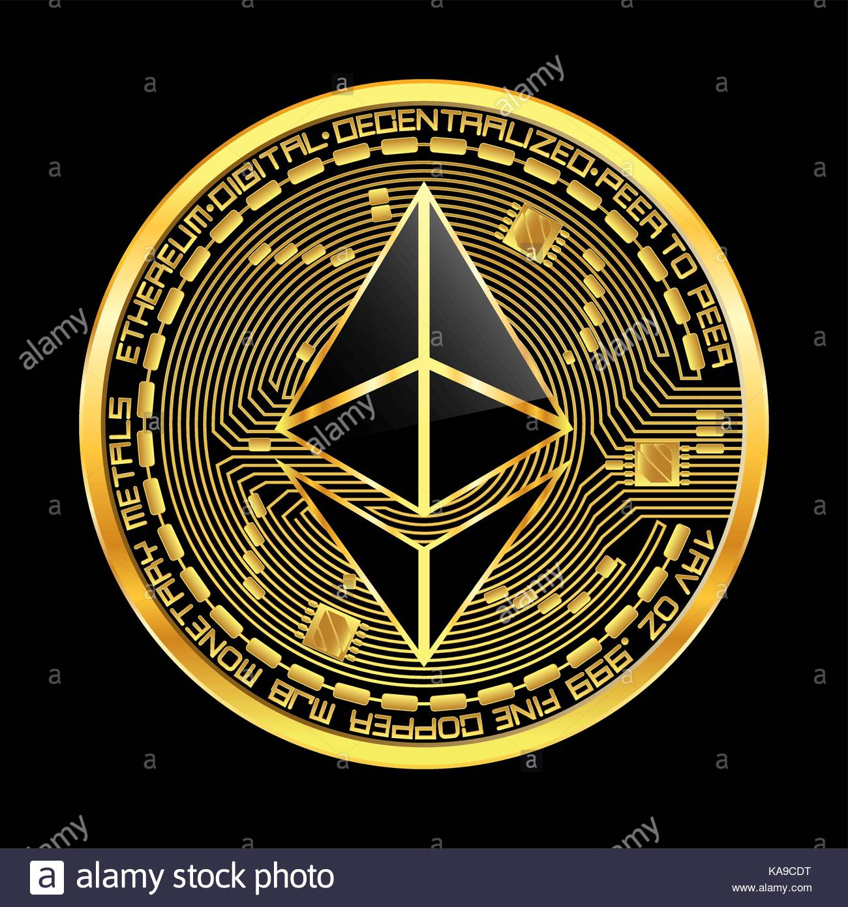
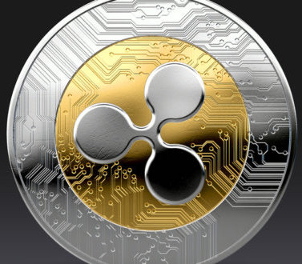
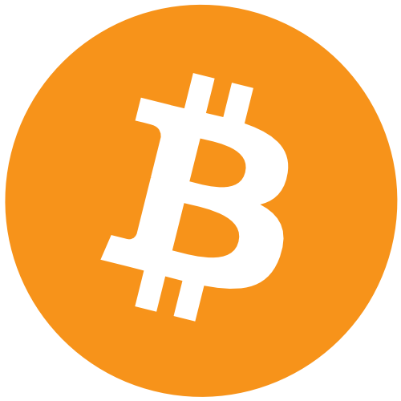
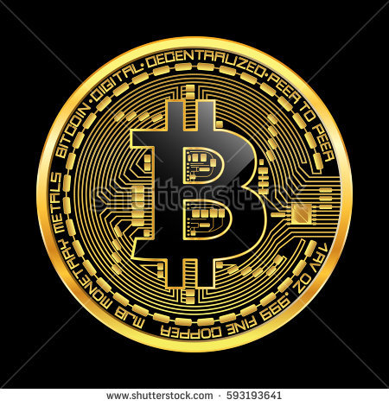

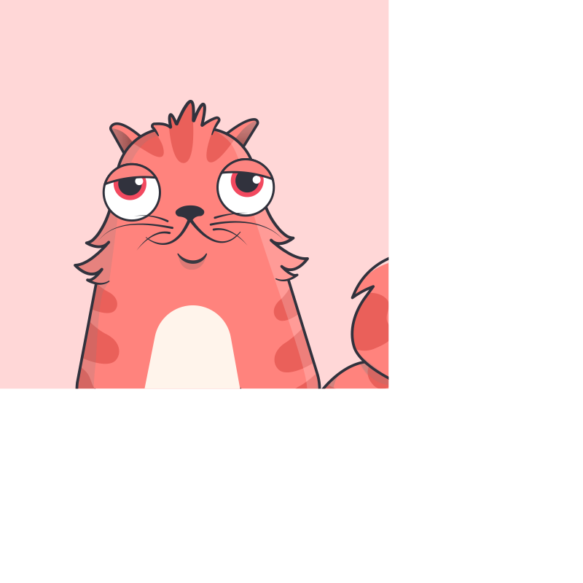
BLOCKCHAIN LANDSCAPE
ETH 2013=>
Ongoing
wallet
wallet
wallet
Currency and Application Layer
Where currency interfaces with markets and transactions. Where applications or DAPPS are developed
Alt coins: Ripple, Litecoin, Dash, Zcash
Equities
Real Estate
Assets
Custom Tokens & NFT
BTC 2009=>
CryptoKitties
Custom Tokens & NFT
Ethereum Currency
Bitcoin
Bitcoin cash
Bitcoingold
DAPPs
Smart (bot) Contracts
Smart (bot) Contracts
Currency Protocol and client Layer
Provides p2p protocol and consensus rules & APIs for the semantics of the currency to the Blockchain layer
BTC protocols
ETH protocols
ERC20
Alternate blockchains:
IBM Hyperledger / Blockcert, OpenChain / Corda, etc.
BLOCKCHAIN LAYER
Provides shared ledger
Stores “chains of blocks” -- all processed transactions in chronological order
Organized group of miners maintain an ordered, time stamped, verified ledger of all transactions.
Cryptography ensures integrity.
PUBLIC or PRIVATE BLOCKCHAIN
PUBLIC BITCOIN
BLOCKCHAIN
PUBLIC ETHEREUM BLOCKCHAIN

Slide 12
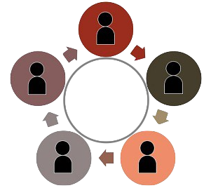
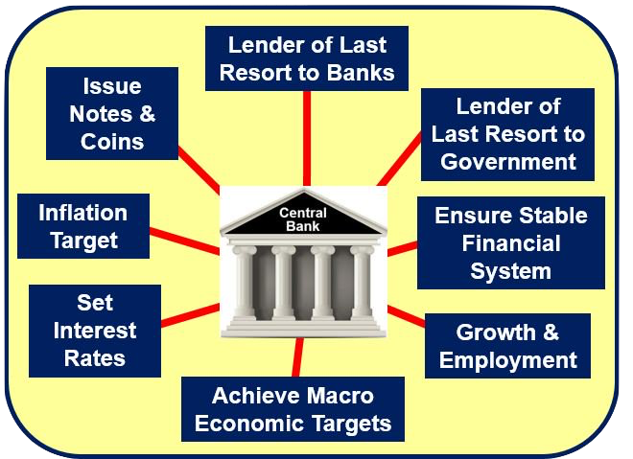
Global & Decentralized Bitcoin vs. US Central Bank, banks, treasury
Central Banks
Bitcoin / Ethereum / Public Blockchains

Slide 13
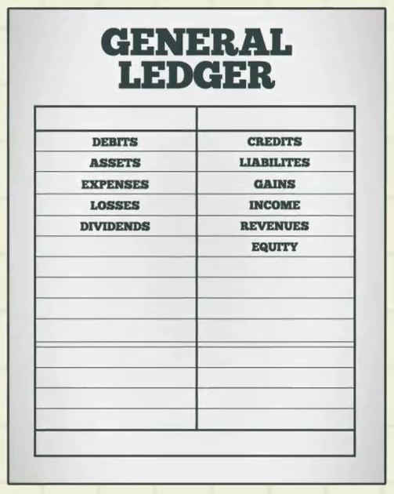
Blockchain = Distributed Ledger Technology
Original Ledger
DLT = Blockchain
Constantly synchronized
Immutable
Time stamped
Decentralized
Notes:
Time stamping is locked into Blockchain. Immutablility is locked in. As is DECENTRALIZTION. Also distributed means no one point of attack.

Slide 14
Blockchain: Operating System for the Global Economy

Slide 15
Blockchain: Operating System for the Galactic Economy

Slide 16
How to access? Wallets
In order to access the WEB3.0, we need a way to add value/currency to our web2.0 world.
Most of the Web3.0 world runs on Ethereum – it is the top currency for developers and for DAPPs.
We need a wallet…

Slide 17
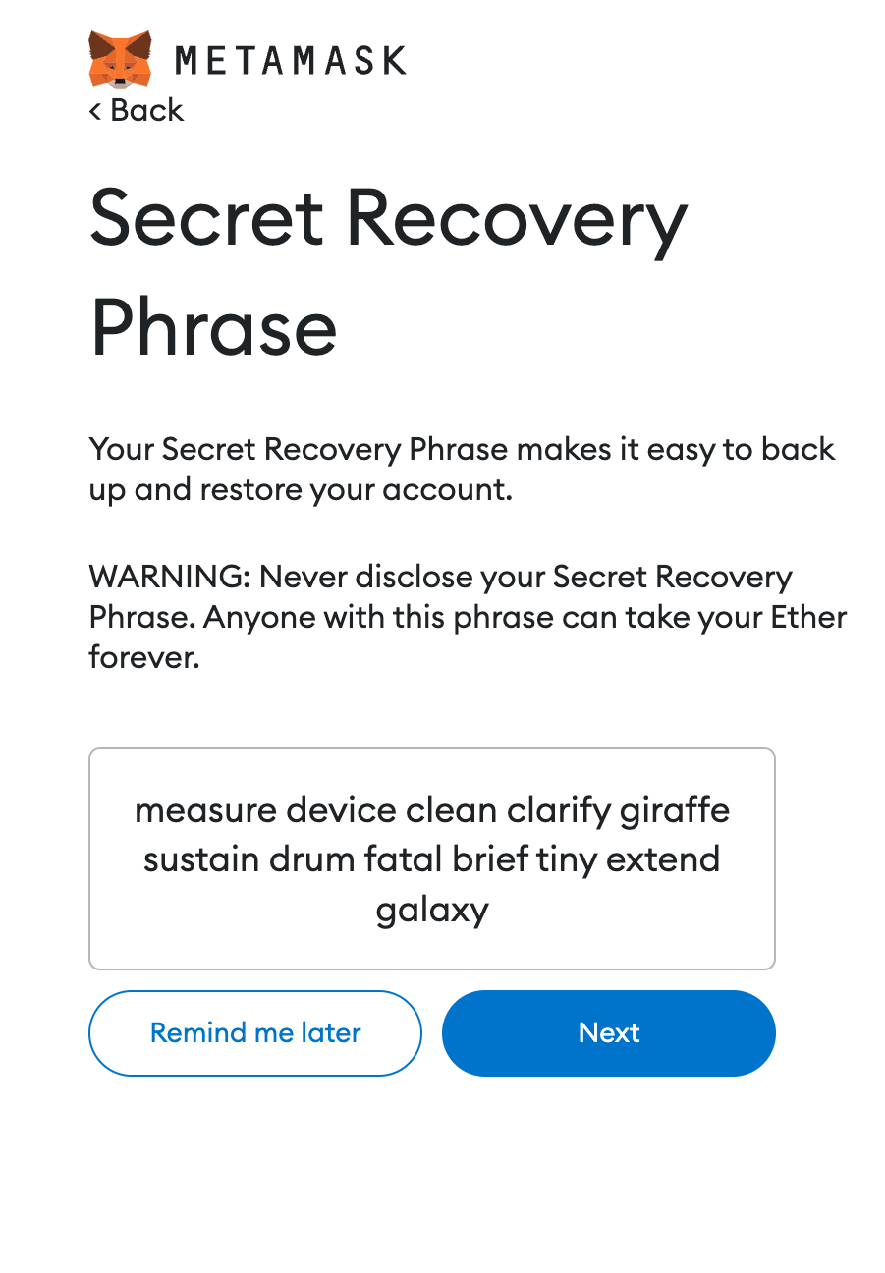
Cryptography intermission
Wallets require a PRIVATE KEY
Which creates a PUBLIC KEY
Core to crypto is a ONE-WAY MATH FUNCTION
Private Keys for Ethereum start with a 12-word mnemonic phrase, taken from ~250,000 words.
Spelling and order is critical for these 12-words
SECURITY OF YOUR ASSETS IS SECURING YOUR PRIVATE KEYS
DON’T SHOW THIS!!!!

Slide 18
Wallets for web3.0
Custody vs. non-custody wallets
Exchange wallets (centralized, custody)
Easy to use. Have been hacked.
Self-custody wallets (decentralized)
More difficult to use
Be careful of phishing attacks!
Hot Storage vs. Cold Storage
Institutional storage

Slide 19
Install Metamask.io browser extension
https://www.youtube.com/watch?v=gHmh3yPYe68
SLOWLY!
grab the extension for your browser (chrome / brave )
Set a password
Have it generate THE 12 WORD MNEMONIC! WRITE THIS DOWN CAREFULLY AND IN THE CORRECT ORDER

Slide 20
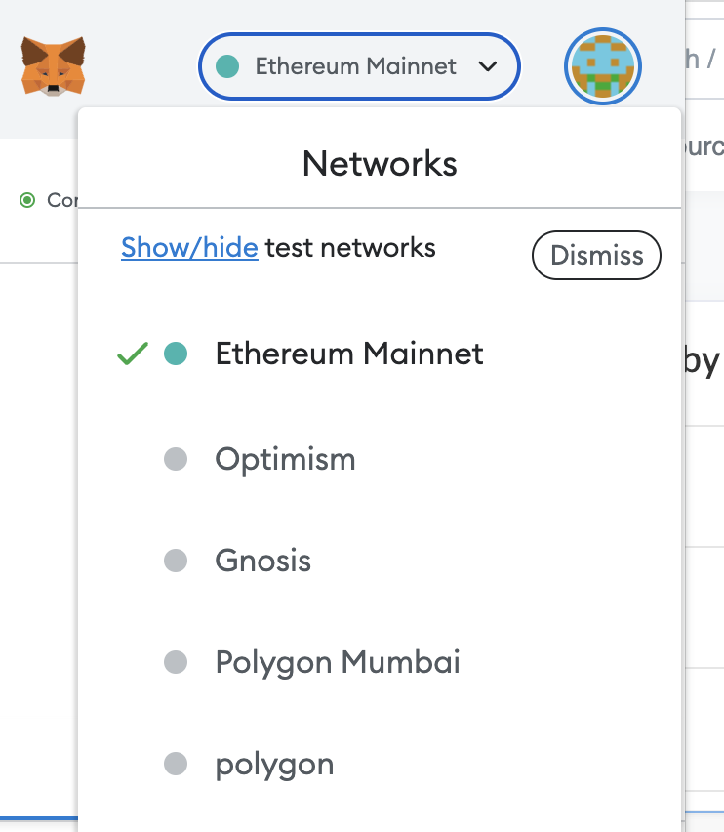
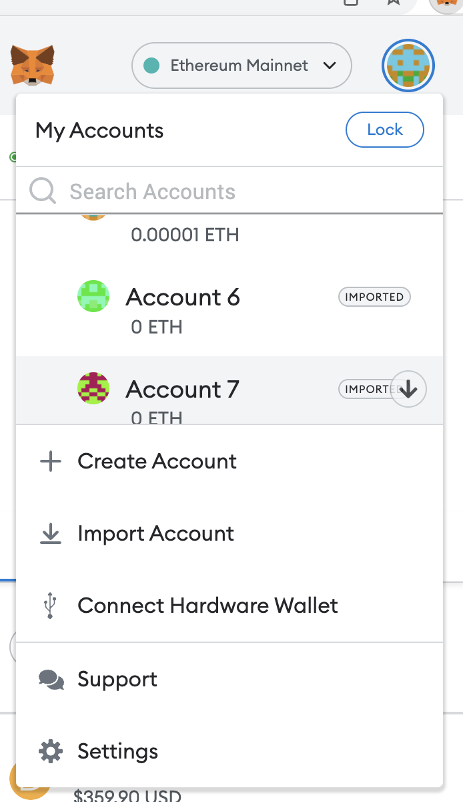
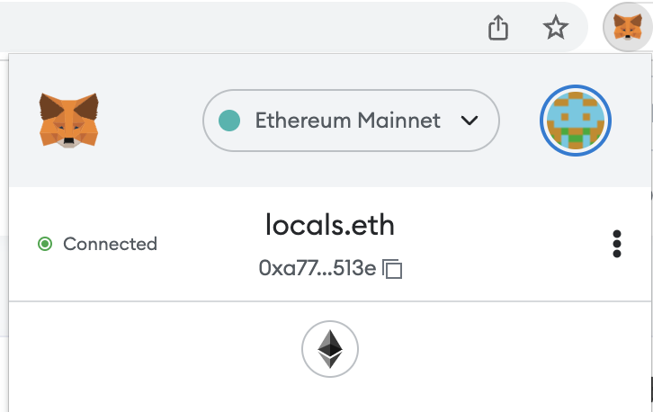
Change Chains
Switch Addresses
Your Wallet Address!

Slide 21
Other Chains
Ethereum Mainnet, PoW (soon PoS), ETH
EVM-compatible chains
Gnosis Chain (fka XDAI), POA chain, XDAI
Polygon (sidechain) PoS, MATIC
Binance, BNB
(many more)
See full list, including testnets here:
https://chainlist.org/
Full list of tokens here:
https://tokenlists.org/

Slide 22
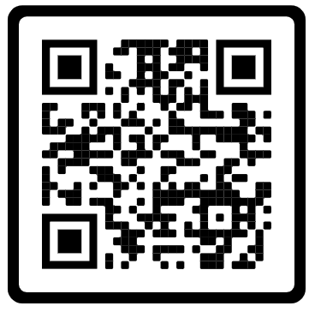
Send ETH (XDAI) to another address in whatsapp
WRITE DOWN:
When you sent it.
How much you sent
Where you sent it
Your neighbor should record:
When they got it.
How much it was
Gas cost (transaction fee)
Whatsapp Invite QR Code

Slide 23
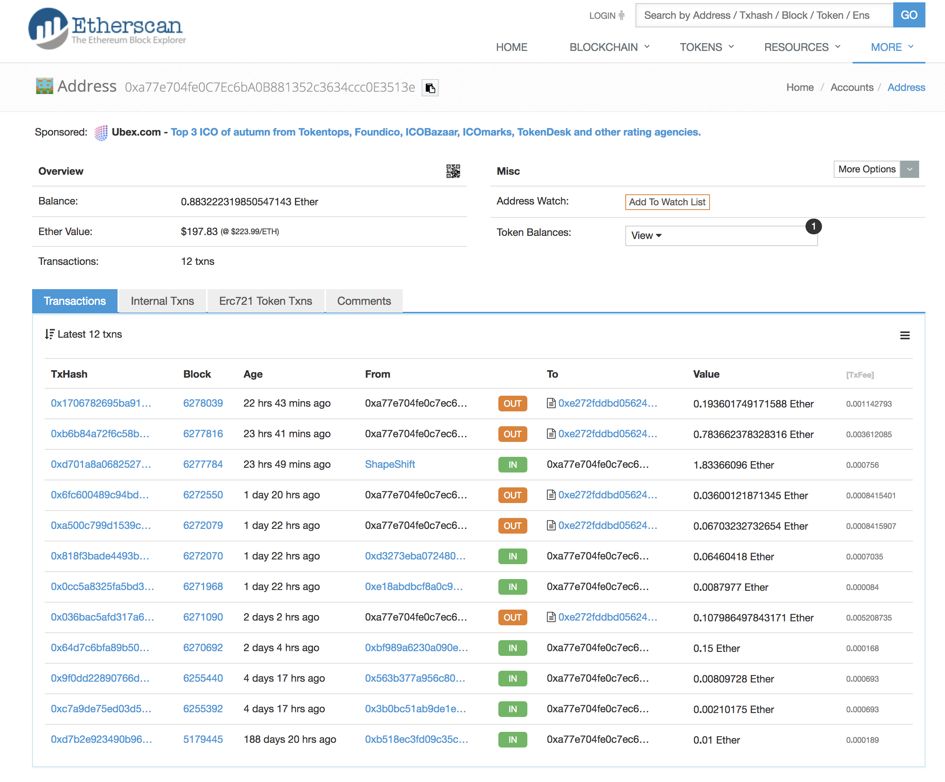
Your Wallet
Address
Etherscan.io

Slide 24
Hashchat intro
With your wallet, connect to:
https://www.hashchat.xyz
or to app: https://betav2.hashchat.xyz
send me a DM and I’ll send you a POAP for this class!
sjdthree.eth is my ETH address.

Slide 25
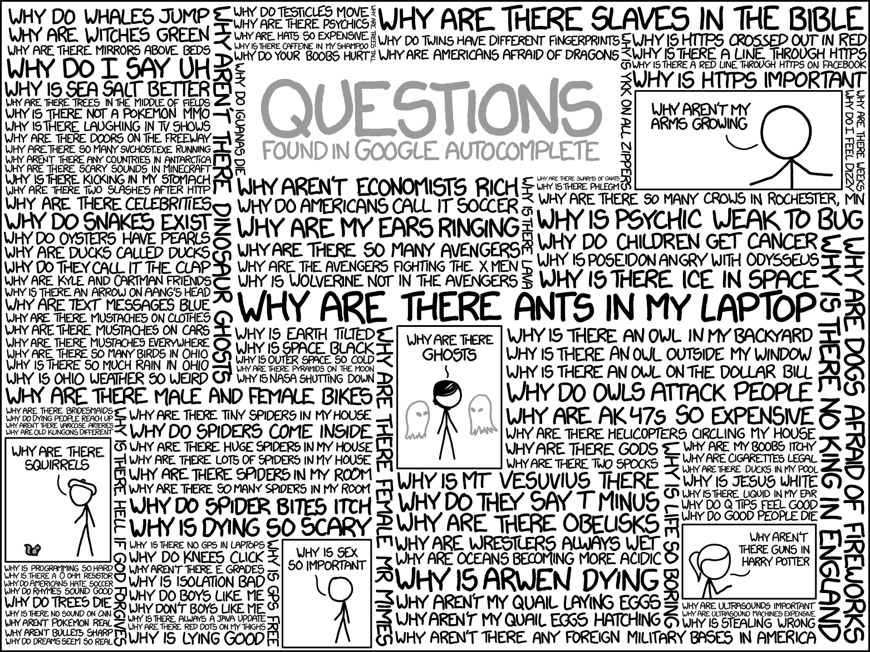
Reference: http://xkcd.com/1256
?

Slide 26
Bitcoin Rap Battle
https://www.youtube.com/watch?v=JaMJi1_1tkA
Lyrics are here:
https://www.digantakobipakho.co.in/2019/09/bitcoin-rap-battle-debate-hamilton-vs-satoshi-lyrics.html

Slide 27
Homework
Lists of Dapps to try:
dappradar.com
Prices of tokens / coins:
coingecko.com or coinmarketcap.com
Swap tokens:
uniswap.org
NFT marketplaces:
opensea.io
Read the bitcoin whitepaper (available in multiple languages):
bitcoin.org
ONBOARD TWO FRIENDS ONTO WEB3!!!!!

